Slide 1
Overfitting and Bag of Words
Sean Kang

Slide 2
What is overfitting
Overfitting occurs when the model too closely fits the training data, and then resulting in the model that cannot make accurate predictions with new data.
When the model learns its training data too much, or learns the irrelevant noise of the data, then the model becomes too overfitted and cannot generalize to new data.
If the model generalize to new data, then it is unable to predict or classify the task that it was designed for.

Slide 3
Underfitting versus Overfitting
If overfitting is detected, perhaps the training should stop, or reduce complexity by removing some irrelevant inputs.
If you pause too early in the model training, then the model is not trained enough on input variables that have a significant relationship between the input and output variables.

Slide 4
What happens with underfitting
Generalizes poorly on unseen data
High bias
Less variance
When the model learns
Bias decreases
Its variance can increase as it gets overfitted
We need to find “sweet spot”

Slide 5
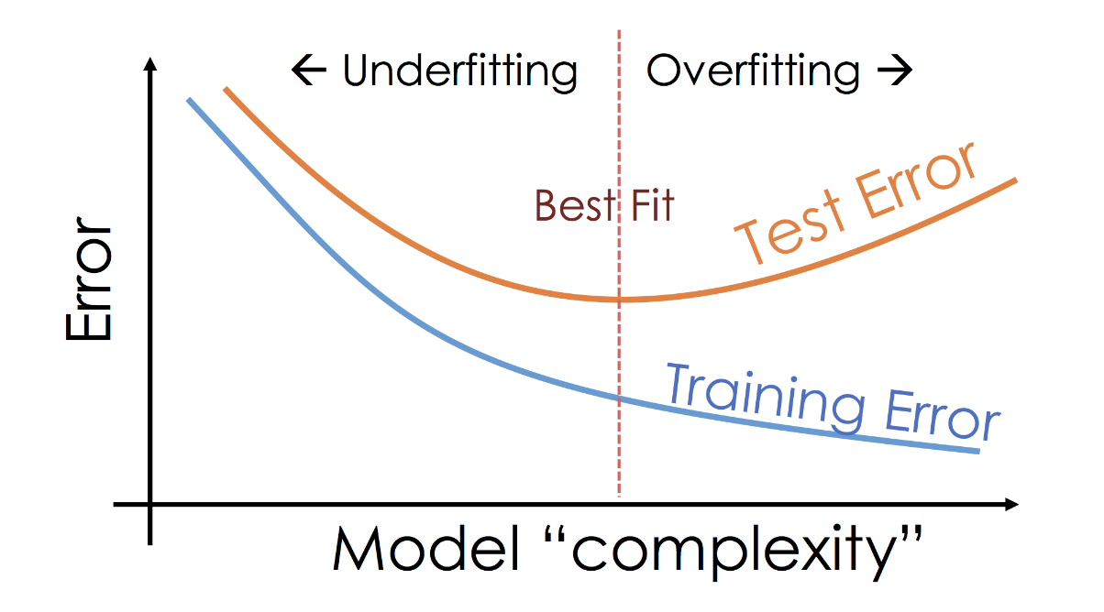
Finding the Sweet Spot

Slide 6
How to detect overfitting?
How to check for model fitness so that your model accuracy is understood.
If the training data has no error rates (ie. low RMSE) and the test data has high error rates, then this is a sign of overfitting.
The most popular technique is to use k-folds cross validation.

Slide 7
What is k-fold cross validation?
Split the data into k pieces or folds.
One of the folds is kept separate and used later for testing.
The remaining folds are used for training.
This process is repeated until each fold is used as the testing fold.
At each iteration of the test, a score is kept.
After all the iterations, an average score is computed to assess the model’s performance.
More on this in separate lecture.

Slide 8
How to avoid over-fitting?
Using linear model helps us to avoid overfitting (however many real-world problems are non-linear)
Train with more data – add more clean, relevant data
Stop early – but can lead to underfitting
Data Augmentation – some adding noisy data make model more stable – done carefully
Feature Selection – Removing redundant, or irrelevant data, and adding most important data
Regularization – this helps us to determine which inputs to remove from model (more later)
Ensemble Methods – a set of classifiers (decision tree) to reduce variance in the datasets (more later)

Slide 9
Bag of Words – Another Feature Engineering
A method for representing text data for machine learning or regression models
Used with natural language processing (NLP)
Notes:
https://machinelearningmastery.com/gentle-introduction-bag-words-model/

Slide 10
Problem with Text
Models and machine learning prefers numerical data, and fixed length structures.
Text or language text isn’t

Slide 11
Bag of Words (BoW)
Occurrence of words in a document
Involves
Vocabulary of words
Measurement of the vocabulary words

Slide 12
Set of vocabulary words
Some EDA or Data Cleaning Needed
Ignore capitalization
Ignore punctuation
Ignore stop words (but, or, and, of, a, etc)
Fix misspelling
Using root words (or stem words)
Sample vocabulary
jump fox quick over the lazy dog cow over the moon brown
Notes:
NLPs such as Stanford NLP has this capability to calculate the root or stem word from a verb in present, or past tense.

Slide 13
NLP
Many open source natural language processing systems
Java
Stanford NLP
https://nlp.stanford.edu/software/
POS – Part of Speech
This can process regular text input and tag each word with POS attributes
Are – to be, Were – to be, Running – to run, Ran – to run
Apache Open NLP
Python
https://stanfordnlp.github.io/CoreNLP/
Notes:
https://stanfordnlp.github.io/CoreNLP/
NLP is fun – I spent too many hours and days playing with this tool.

Slide 14
Define a vector based on vocabulary
Based on this vocabulary:
jumps fox quick over the lazy dog cow moon brown
Each document would have this vector:
The quick brown fox jumps over the lazy dog
[1, 1, 1, 1, 2, 1, 1, 0, 0, 1]
The cow jumps over the moon
[1, 0, 0, 1, 2, 0, 0, 1, 1, 0]
The cat in the hat
[0, 0, 0, 0, 2, 0, 0, 0, 0, 0] -> sample of sparse vector
Documents those known words are encoded. Other words are ignored
The order of the words are ignored

Slide 15
How to Score
Counts – absolute count of word in the document
Frequency - frequency relative to other words in document (1 of 1000 words in document)

